Slide 1

PRESENTATION ON:
TYPING GAME : Space Typers

Slide 2

TEAM MEMBERS CONTRIBUTING TO THE PROJECT
NAMES
DIYA BISHT
GARIMA BISHT
JYOTSNA PANT

Slide 3

PRESENTATION OUTLINE:
Presentation Outline
Introduction
Academic Objective
Technology platform overview
Implementation
Application Snapshot
Conclusion
Demonstration

Slide 4

Introduction
Introduction
One of the primary benefits of playing typing games is the improvement in typing speed.
These games are specifically designed to challenge your typing skills by presenting you with various exercises that require quick and accurate keystrokes.
While speed is important, accuracy is equally crucial when it comes to effective typing.

Slide 5
Why typing games are helpful
By engaging in these games, learners are encouraged to type quickly and accurately to achieve their objectives.

Slide 6
Technology Platform
Website ✓ Languages used:
1. HTML (Hyper Text Markup Language)
2. CSS (Cascading Style Sheet)
3. Javascript
✓ Platform:

Slide 7
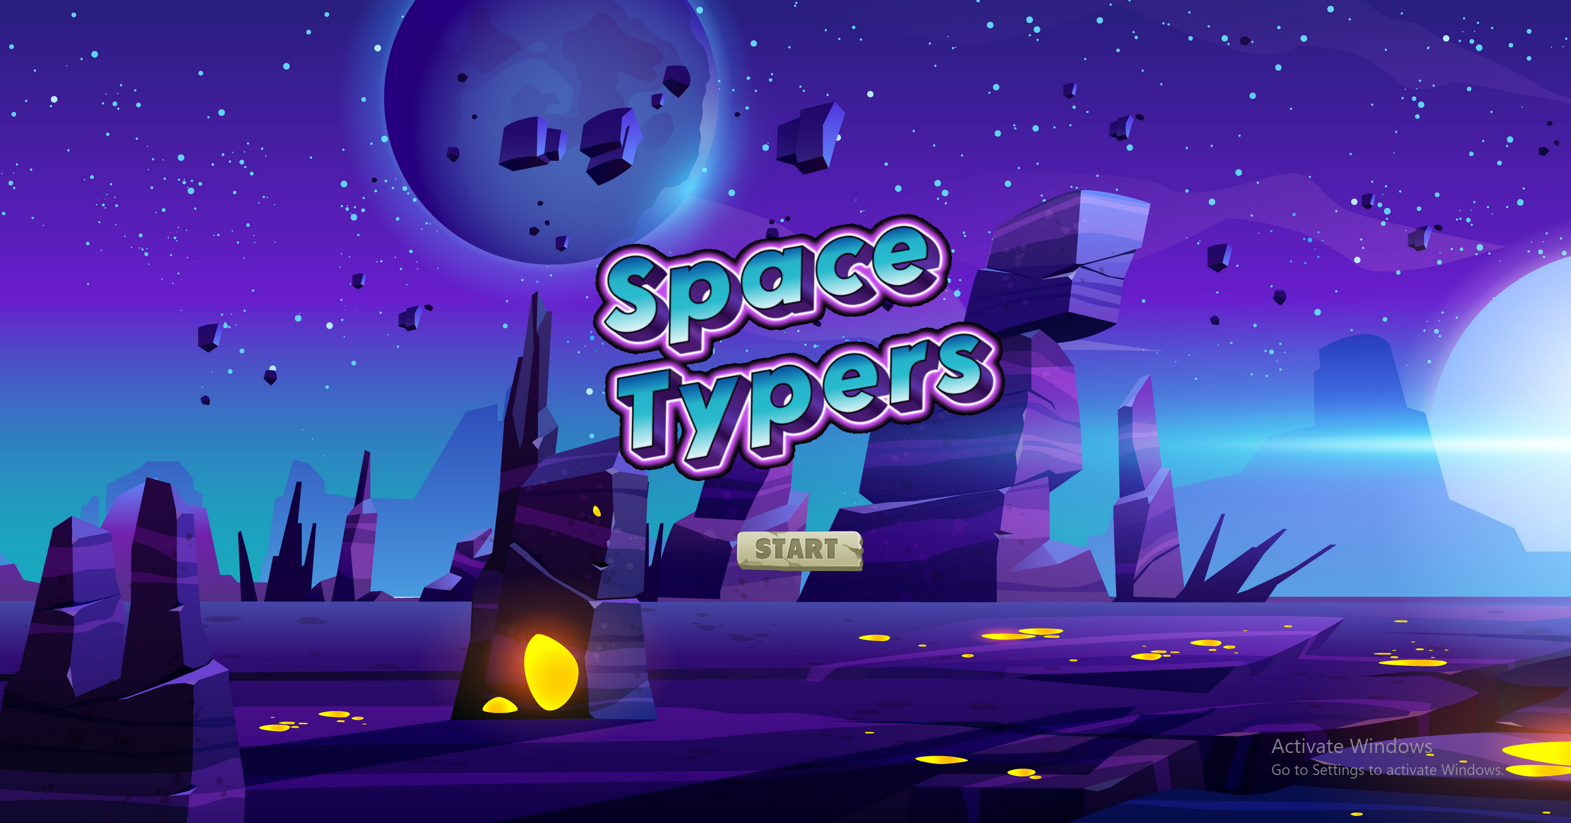
Home Page:

Slide 8
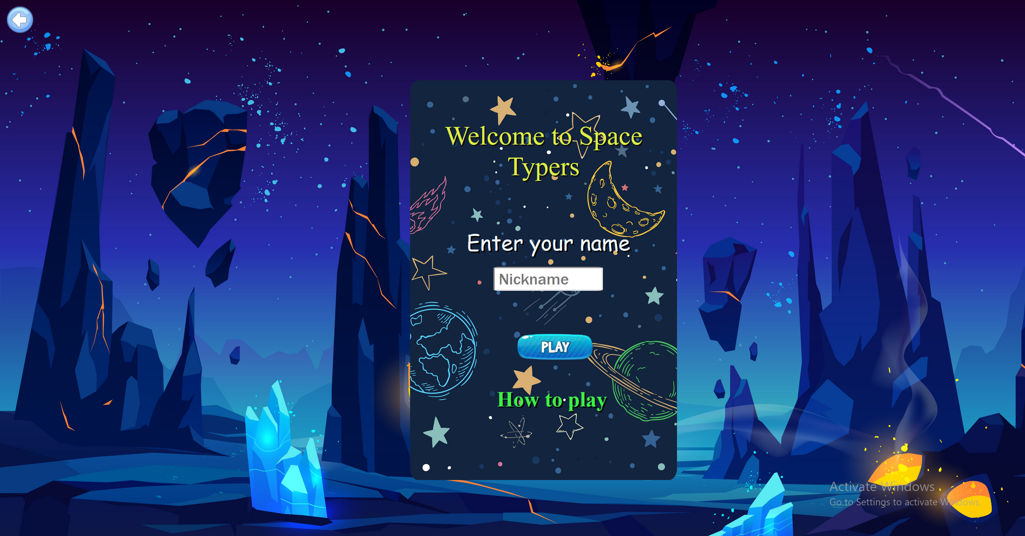
Menu:

Slide 9
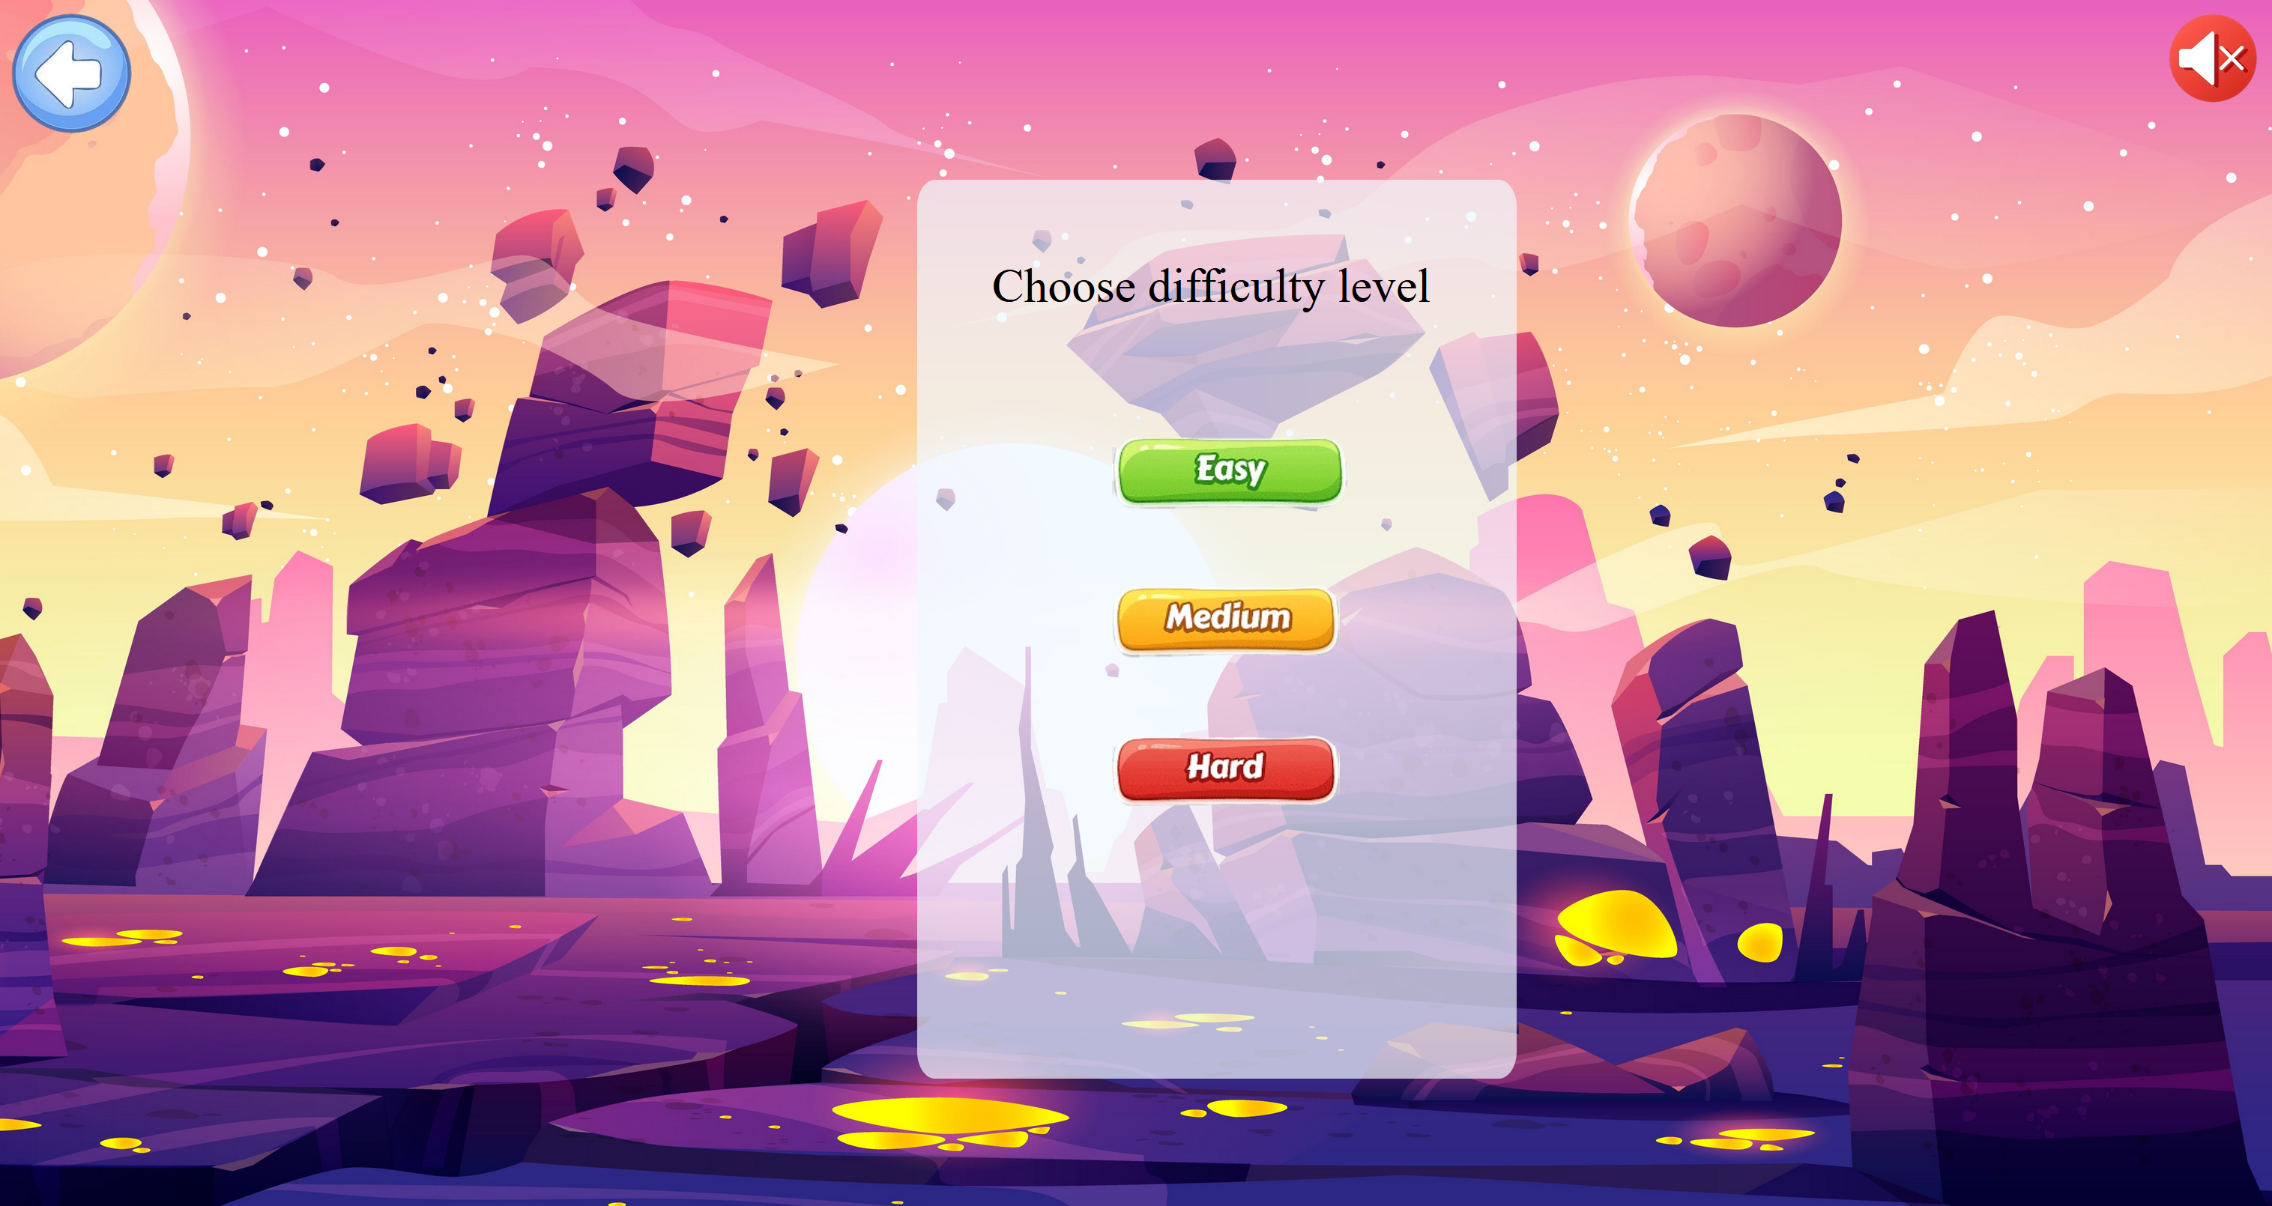

Slide 10
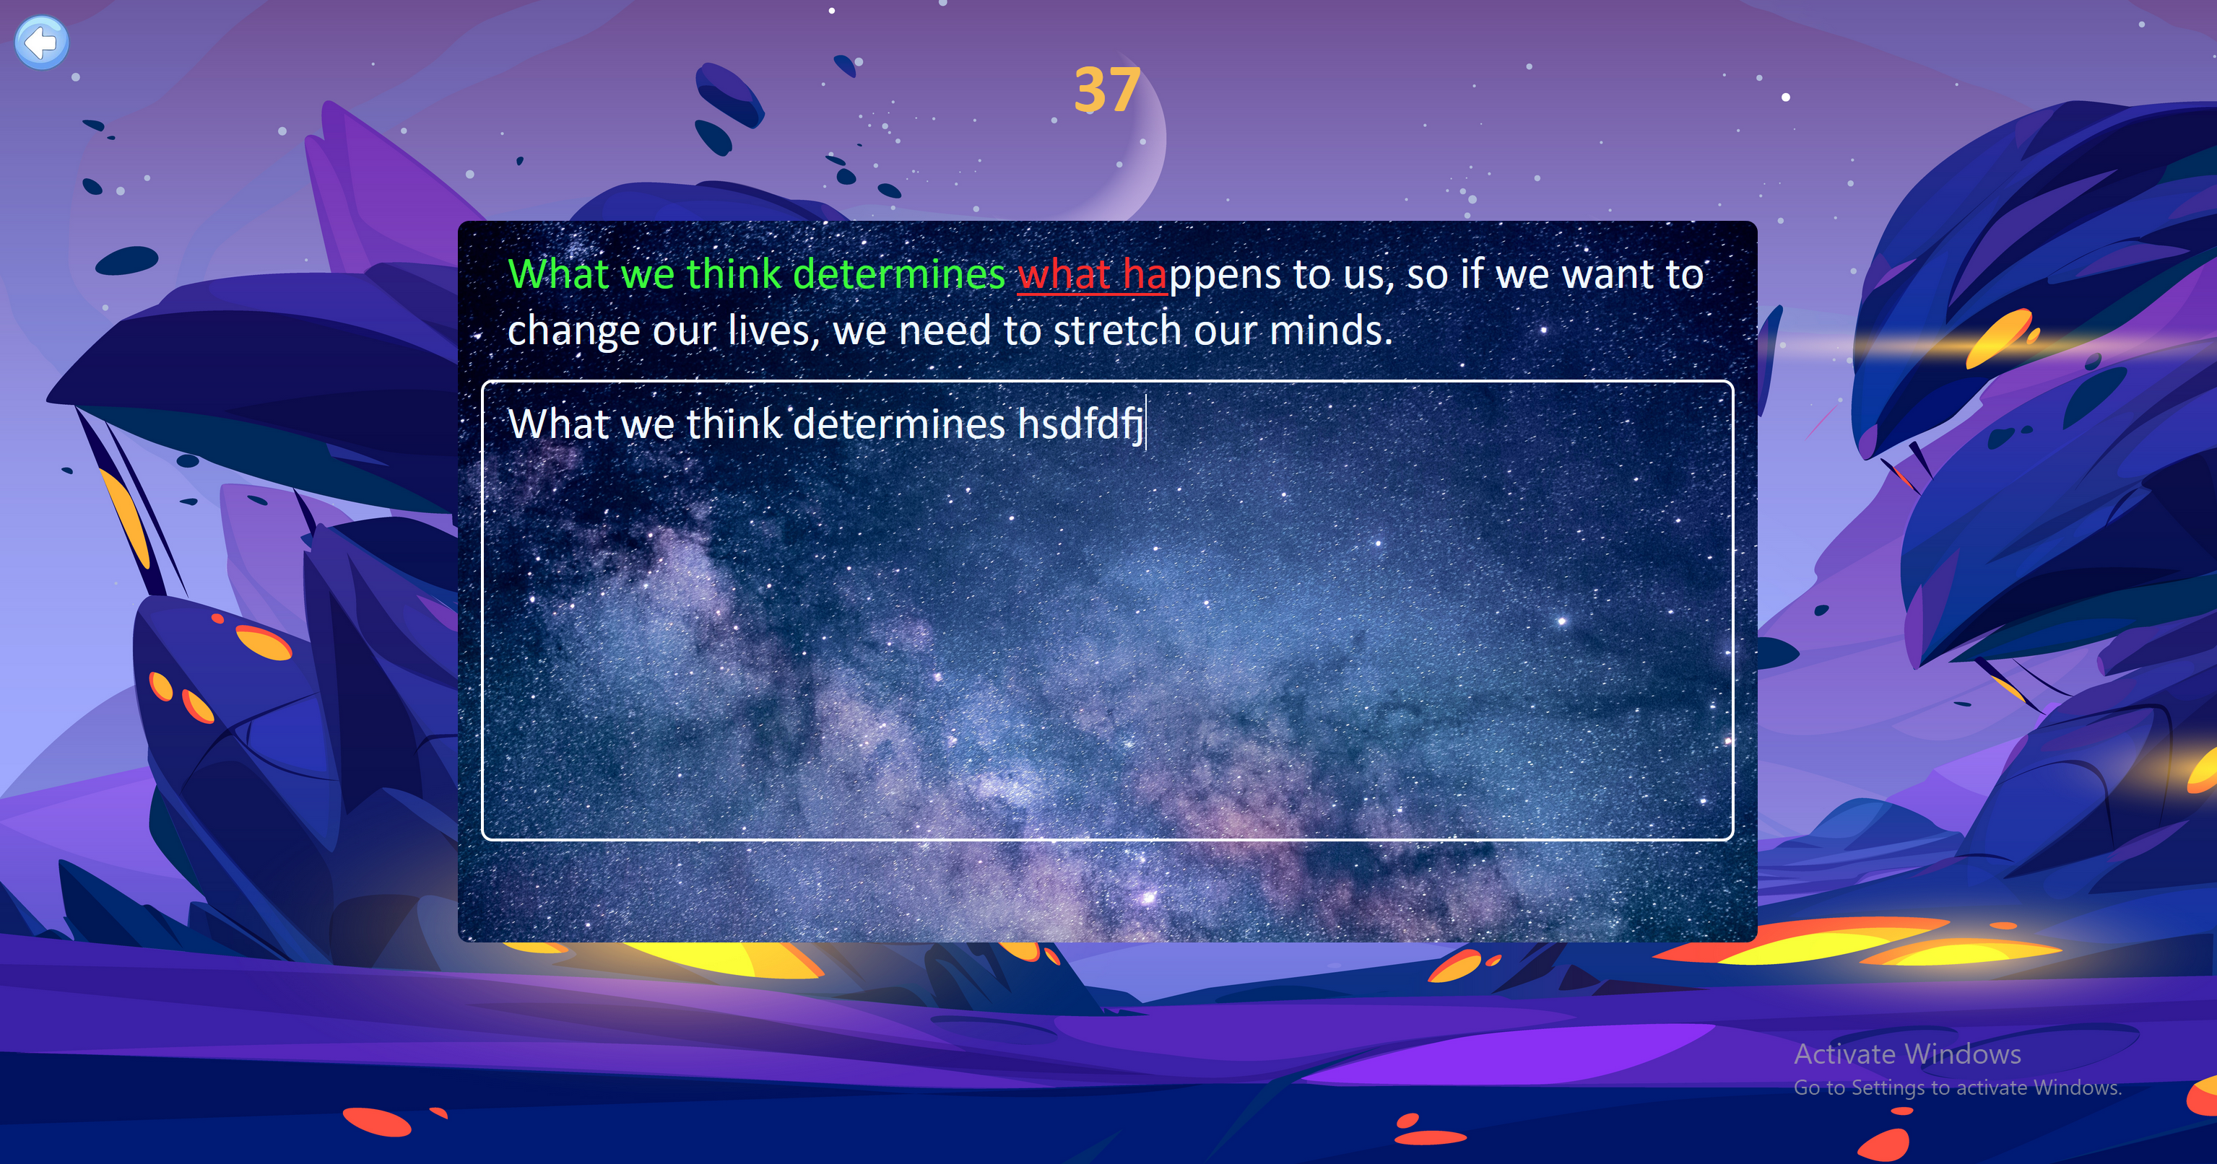
Main Page:

Slide 11
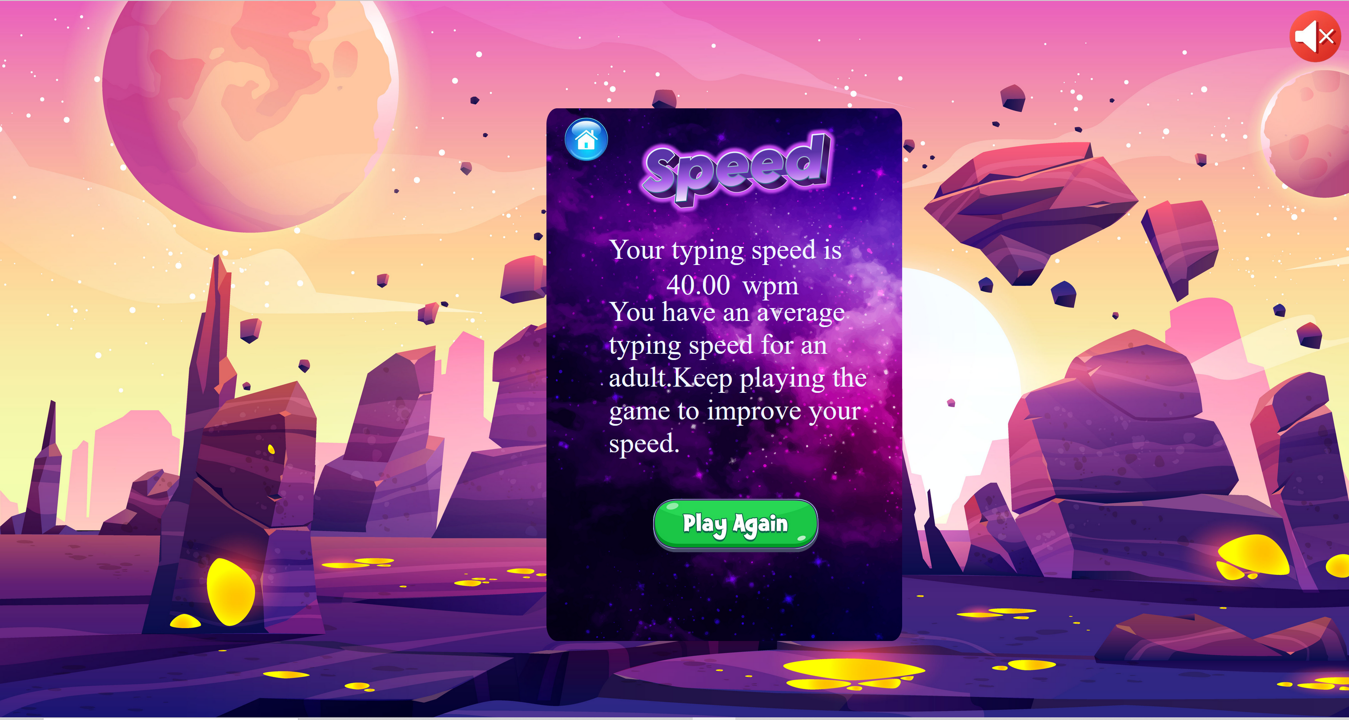
Scoreboard:

Slide 12
CHALLENGES FACED
Lack of experience
Had to start from the scratch
Learning Process

Slide 13

CONCLUSION
CONCLUSION
In conclusion, typing games offer a multitude of benefits for kids. They improve typing speed and accuracy, enhance hand-eye coordination and fine motor skills, promote language proficiency, and foster problem-solving and critical thinking abilities.
They help struggling students with reinforcement and review and provide high-interest texts for more accurate typists.

Slide 14

THANK YOU

